Slide 1






RFID Badge Cloning and Protection Mechanisms
Created by Reem hany Abd El raouf 20236039,
Marwan ossama Hussein 20235035,
Moaz Mohamed salah 20236063.

Slide 2









Introduction to RFID Technology
What is RFID Technology?
Radio-Frequency Identification (RFID) technology uses electromagnetic fields to automatically identify and track tags attached to objects. It enables contactless communication between a tag and a reader, facilitating various applications across industries.
Ubiquitous Applications
Supply Chain
Access Control
Payment Systems
Streamlining inventory tracking and logistics
Facilitating secure building and system access
Enabling secure and convenient transactions
Security Challenges
Badge Cloning Vulnerability
While offering convenience, RFID systems face significant security challenges. The widespread adoption introduces inherent vulnerabilities, particularly concerning badge cloning, where unauthorized duplicates can be created to bypass security measures.
RFID Badge Cloning and Protection Mechanisms

Slide 3

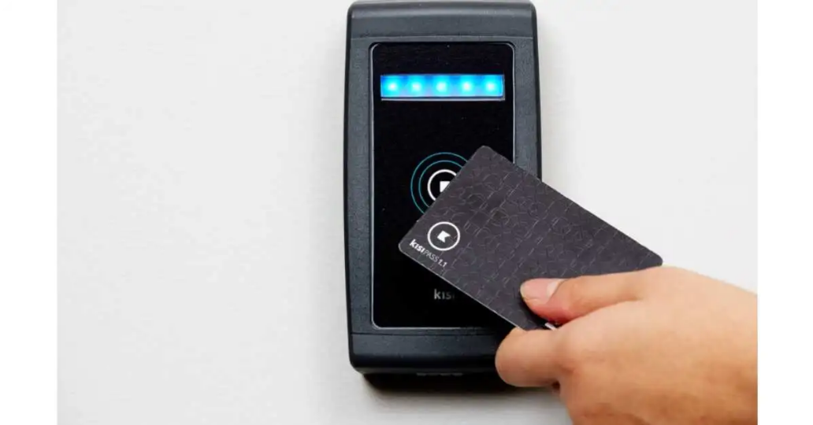




















Core Components of RFID Systems
RFID Tag interacting with Reader
RFID Tag (Badge)
RFID Reader
Back-End System
Small microchip attached to an antenna
Emits radio waves to activate tags
Server and database infrastructure
Reads data from tags
Application software for processing
Stores data, including unique identifier
Converts radio waves to digital data
Receives and processes tag data
Sends data to host computer
Performs actions (access, tracking, payment)
Transmits data when activated
Can be passive or active (self-powered)
Working together: These three components form an integrated system that enables wireless identification and data exchange. When a tag enters the reader's field, it responds with its stored data, which the reader converts and sends to the back-end system for processing and action.
RFID Badge Cloning and Protection Mechanisms

Slide 4







RFID Operating Frequencies
RFID systems operate across various frequency bands, each with distinct characteristics influencing their application in access control systems.
Low Frequency (LF)
High Frequency (HF)
125-134 kHz
13.56 MHz
Characteristics:
Characteristics:
Short read range (few centimeters)
Moderate read range (up to a meter)
Slower data transfer rates
Faster data transfer speeds
Less susceptible to interference from liquids or metals
More data storage capacity
Applications:
Applications:
Basic access control
Enhanced security access
Simple building access systems
Requires more data storage and security
Common cards: EM4100
Common cards: Mifare Classic, DESFire EV1/EV2
RFID Badge Cloning and Protection Mechanisms

Slide 5


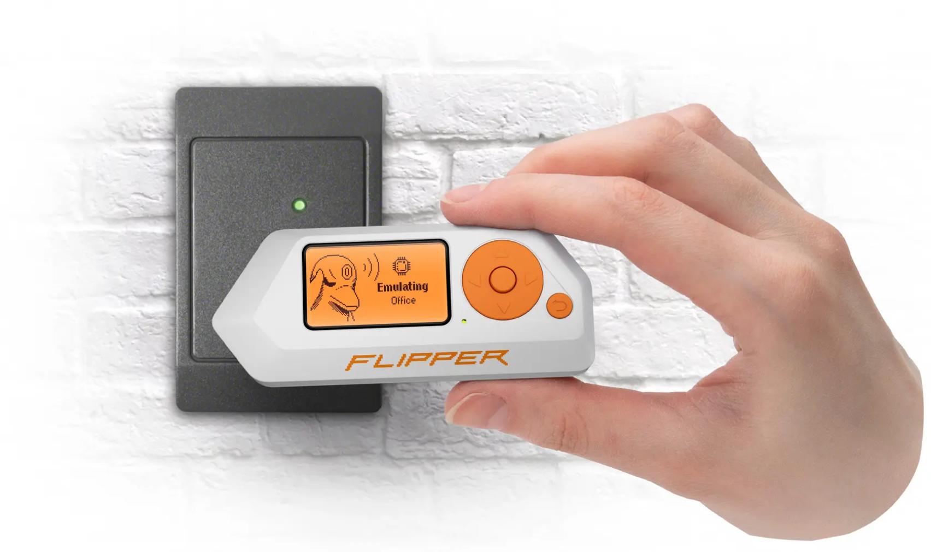












The Threat: RFID Badge Cloning
What is Badge Cloning?
RFID badge cloning involves creating an unauthorized duplicate of an existing RFID access credential, allowing an attacker to bypass physical security measures.
Why It Matters
Requires minimal technical expertise
Uses readily available, inexpensive tools
Difficult to detect without specialized monitoring
Flipper Zero device being used to interact with an access card reader
How Cloning Bypasses Security
Read UID: Attacker reads the static UID from a legitimate badge
Security Implications
Cloned badges can be used to gain unauthorized access to secure facilities, bypassing physical security measures and potentially causing significant damage to an organization's operations and reputation.
Copy Data: Extracts and stores the UID and other data
Create Duplicate: Writes the copied data to a blank card
RFID Badge Cloning and Protection Mechanisms

Slide 6











Badge Cloning Process
Step 1: Covert Reading
Step 2: Copy UID
Step 3: Write to Blank
Attackers use specialized RFID readers, often disguised or concealed, to scan legitimate badges when they're in close proximity.
The device extracts the unique identifier (UID) and other unencrypted data stored on the tag.
The extracted UID and data are written onto blank, writable RFID cards. These blank cards are inexpensive and widely available.
Key Insight
The simplicity of this process, combined with the accessibility of tools and blank cards, makes RFID badge cloning a significant security concern. Attackers can often complete the process with minimal technical expertise and readily available tools.
RFID Badge Cloning and Protection Mechanisms

Slide 7





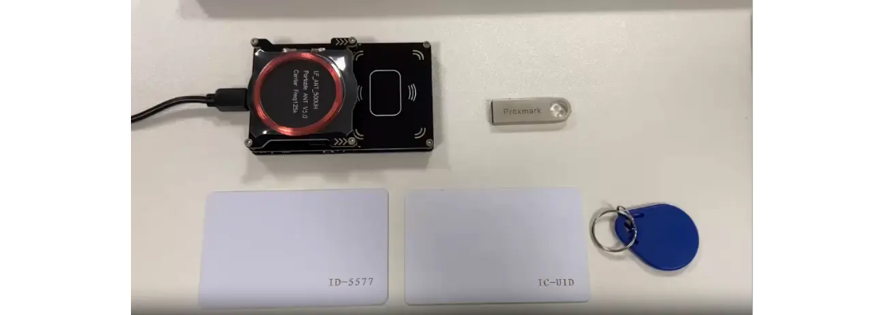
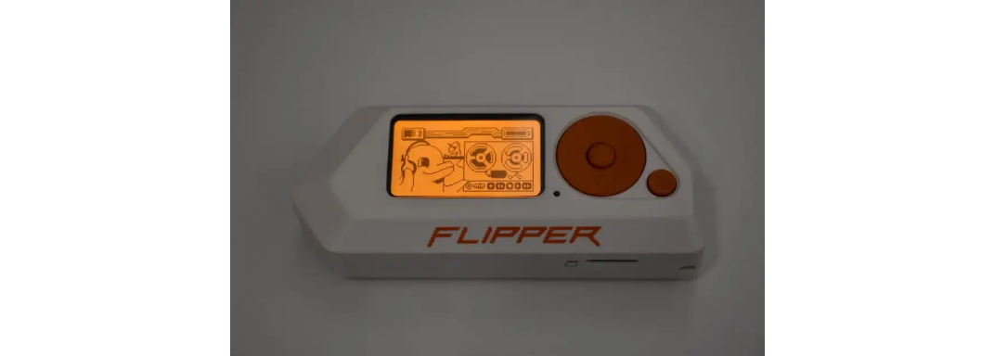




Tools Used for Cloning
Attackers utilize a range of hardware and software tools for RFID badge cloning, many of which are accessible and relatively low-cost, contributing to the widespread nature of this threat.
Proxmark3
Flipper Zero
Mobile Apps
Open-source RFID research tool
Multi-tool device for pentesters
Smartphones with NFC readers
Reads, writes, and sniffs tags
RFID and NFC capabilities
Limited to HF frequencies
Operates across LF and HF frequencies
Reads, emulates, and writes tags
Common phone becomes cloning tool
Key Insight: The accessibility and relatively low cost of these tools contribute to the widespread nature of RFID badge cloning as a security threat.
RFID Badge Cloning and Protection Mechanisms

Slide 8






Vulnerable RFID Systems
Static UID Vulnerability
Systems that rely solely on the static Unique Identifier (UID) of an RFID card are highly susceptible to cloning attacks. This vulnerability stems from the fact that the UID is often transmitted in plain text and does not change, making it easy to intercept and duplicate.
Low Frequency (125 kHz)
High Frequency (13.56 MHz)
Among the simplest and most widely used for basic access control
More complex than EM4100 but still vulnerable
Known cryptographic vulnerabilities allow UID and sector data to be read
Transmit a fixed, unencrypted UID
EM4100
Extremely easy to clone with basic LF readers and writers
Mifare Classic
Many older access control systems still utilize these cards
Despite their vulnerabilities, these card technologies remain widely deployed due to their simplicity, cost-effectiveness, and perceived adequacy for basic access control needs.
RFID Badge Cloning and Protection Mechanisms

Slide 9








Protection Mechanisms: Encryption and Authentication
Strengthening RFID Security
Secure RFID systems implement cryptographic techniques and authentication protocols to prevent unauthorized access and cloning.
Dynamic Authentication
Challenge-Response Authentication
The reader issues a unique challenge to the card, which responds with a cryptographically generated answer, preventing simple replay attacks.
Security Comparison
Vulnerable Systems
Secure Systems
Advanced Security Solutions
• Static UIDs
• Dynamic authentication
NXP DESFire EV1/EV2
• Plain text transmission
• Encrypted communication
Implements AES encryption and mutual authentication, providing strong protection against cloning.
• No encryption
• Mutual verification
RFID Badge Cloning and Protection Mechanisms

Slide 10











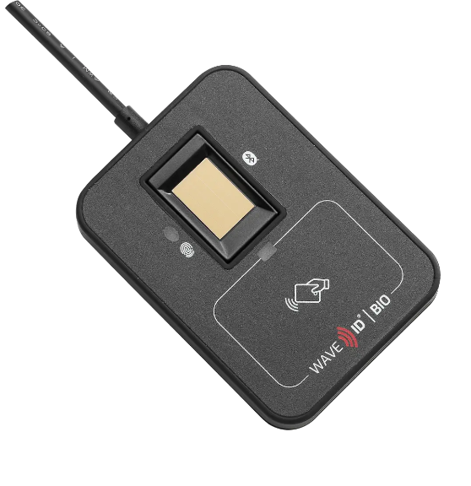

Multi-Factor Authentication
Enhanced Security through Multiple Verification Methods
Multi-Factor Authentication (MFA) significantly enhances physical access control security by requiring users to present two or more distinct forms of verification before granting access.
RFID + PIN Code
RFID + Biometrics
User must present badge and enter PIN
Badge with fingerprint/iris scan verification
Benefits of MFA
Even if one factor is compromised, access remains protected
Significantly increases difficulty for unauthorized access
RFID + Mobile
Dual Card
Verifies user identity through multiple verification methods
Badge with mobile code or approval
Two badges for sensitive areas
WAVE ID® Bio Reader
RFID Badge Cloning and Protection Mechanisms

Slide 11













System-Level Defenses
Beyond individual card and reader security, robust system-level defenses are essential for a comprehensive security posture. These measures are implemented on the back-end access control system to detect and prevent anomalous activities.
Anomaly Detection
Anti-Passback Rules
Time-Based Restrictions
Monitors access patterns for unusual behavior, such as a single badge being used at geographically impossible locations within a short timeframe.
Prevents badge misuse by ensuring a user cannot pass their badge back to another person. Can be implemented as hard (blocking re-entry) or soft (logging violations).
Limits badge access to specific times or days, ensuring that even if a badge is cloned, its utility is restricted to authorized periods.
Regular Security Audits
Video Surveillance Integration
Comprehensive Protection
Periodic reviews of access control system logs, configurations, and physical security measures to identify vulnerabilities and ensure compliance.
Links access events with video footage allows for visual verification of individuals using badges, helping to identify unauthorized use.
System-level defenses provide layered security that complements card-level protections, creating a defense-in-depth approach to RFID security.
RFID Badge Cloning and Protection Mechanisms

Slide 12



Conclusion
Key Takeaways
1 - RFID technology offers undeniable convenience, but this comes with inherent security vulnerabilities, particularly the risk of badge cloning. Effective security against such threats necessitates a layered defense strategy rather than reliance on a single protective measure.
2 - Provide Security Awareness Training
Educate employees on the importance of protecting their RFID badges. Training should cover topics such as not lending badges, reporting lost or stolen badges immediately, and being wary of suspicious individuals attempting to read badges covertly
.
Continuous awareness and proactive implementation of security protocols are paramount
RFID Badge Cloning and Protection Mechanisms

Slide 13
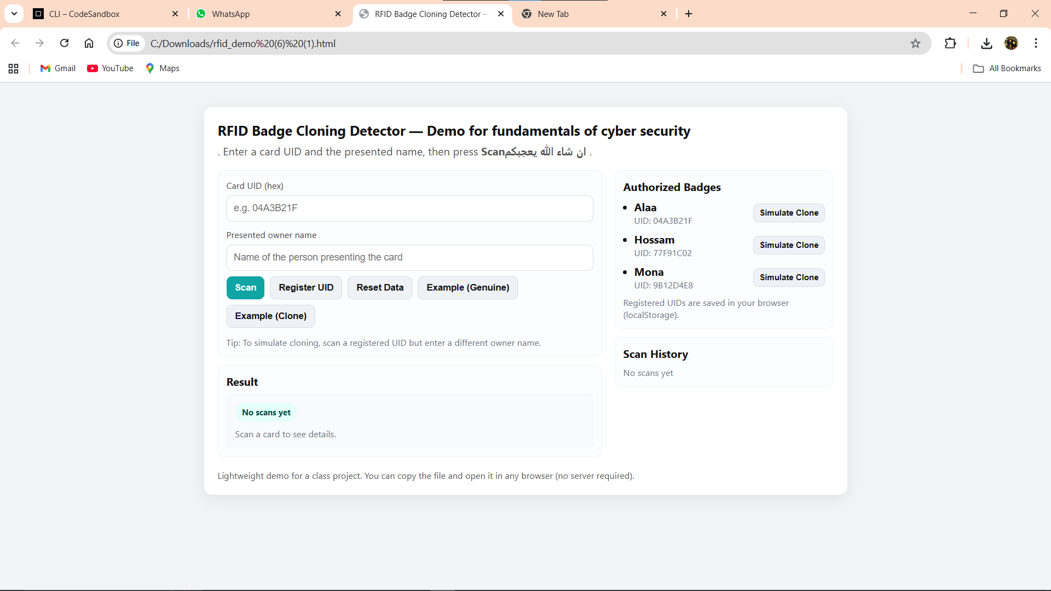
RFID Badge Cloning Detector demo
.
RFID Badge Cloning and Protection Mechanisms

Slide 14
Right Panel — Authorized Badges
What is 'Authorized Badges'?
• This is the demo's 'database' of trusted badges kept in the browser (localStorage).
• Each entry: { uid: 'HEX', owner: 'Name' } — UID is the key, owner is the expected presenter.
Entries shown in screenshot:
• Alaa — UID: 04A3B21F (Simulate Clone)
- Means: if a card reads UID 04A3B21F and name 'Alaa' →
Genuine.
- Simulate Clone button: inserts a fake usage of the same UID with a different owner to show detection.
• Hossam — UID: 77F91C02 (Simulate Clone)
• Mona — UID: 9B12D4E8 (Simulate Clone)
Note: localStorage persists per browser — other users/machines won't see these entries
.
RFID Badge Cloning and Protection Mechanisms

Slide 15
Left Column — Inputs & Controls
Card UID (hex) — Purpose & Details
• Purpose: uniquely identifies an RFID badge (presented as hex).
• Why needed: server-free identity check — UID is the primary key.
• Validation in demo: normalized to uppercase and trimmed; no cryptographic checks.
Presented owner name — Purpose & Details
• Purpose: captures the person claiming to present the card.
• Why needed: allows detection of mismatches when same UID used by different person.
• Limitation: name is free-text; can be easily spoofed.
Buttons — What they do (UX -> code)
• Scan — triggers detect(uid, owner) and recordResult(...). Clears inputs after scanning.
• Register UID — adds (uid, owner) to Authorized Badges (localStorage).
• Reset Data — clears localStorage (authorized list + history).
• Example (Genuine) — fills inputs with a registered UID and matching owner.
• Example (Clone) — fills inputs with a registered UID but different owner to show cloning.
.
RFID Badge Cloning and Protection Mechanisms

Slide 16
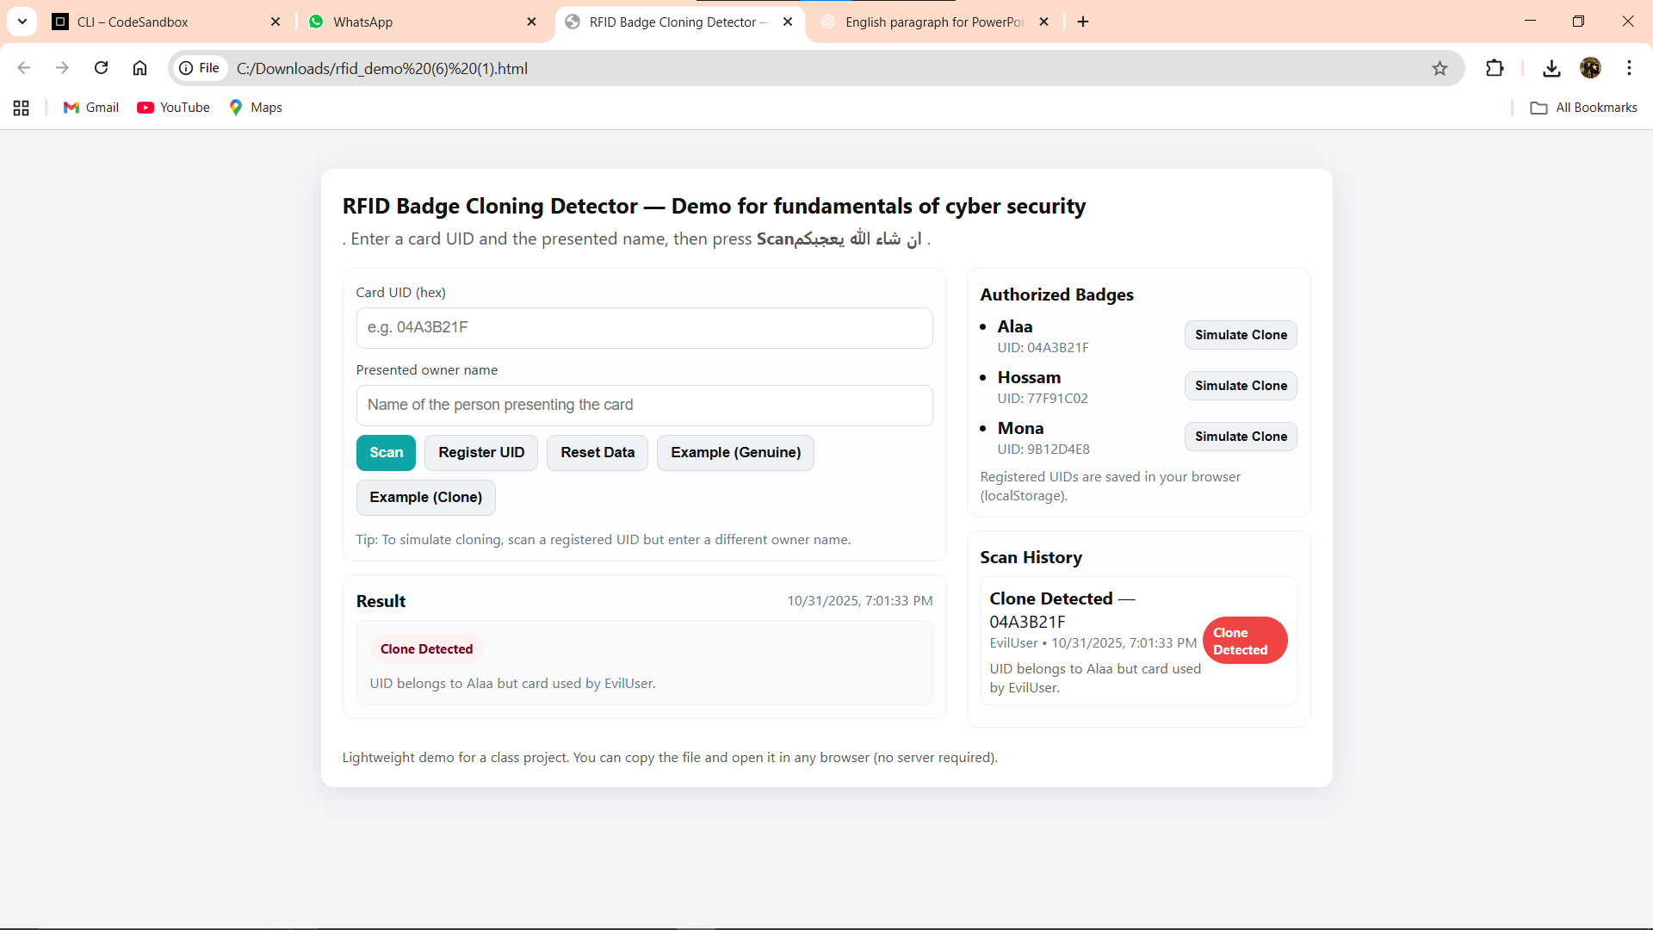
Simulate Clone — Purpose & Behavior
• What simulate clone does:
• It creates an entry in Scan History where the same UID is used by a different owner (e.g., 'FakeUser').
• Shows the UI result 'Clone Detected' and a red status pill — illustrates detection logic without needing a real cloned card.
Why it's useful:
• Educational: demonstrates the exact mismatch condition the system uses to flag cloning.
• Reproducible: instructors can reproduce the cloning case during demos.
Limitation:
• It's a simulated event — real cloning might involve replay attacks, sector/key cloning, or different UID strategies.
.
RFID Badge Cloning and Protection Mechanisms

Slide 17
Scan History & Result
Scan History
• Shows a timestamped list of recent scans (status, uid, owner, reason).
• Implemented by recordResult() which pushes to an array and saves to localStorage.
• Useful for audit and forensic demonstration in class; limited retention (keeps last 200 entries).
Result Box
• Shows the immediate result of a scan: status pill (Genuine/Clone/Unknown) and a short reason.
• Visual cues: green-ish for Genuine, red for Clone Detected, yellow for Unknown.
• Implemented by showResult() which sets text and styles.
.
RFID Badge Cloning and Protection Mechanisms

Slide 18
Limitations, Security Notes & Extensions
Limitations
• UID as sole identifier is weak: many real systems use cryptographic authentication or unique keys per sector.
• localStorage is not secure or shared across machines—suitable for demos only.
• Name field is free-text and can be spoofed; real systems use additional verification (PINs, biometrics).
Possible extensions
• Server-side logging + central authorized DB for audit and revocation.
• Use challenge-response or cryptographic tokens instead of plain UID.
• Add rate-limiting, alerting, and locking for repeated clone attempts
.
RFID Badge Cloning and Protection Mechanisms

Slide 19
THANK YOU
.
RFID Badge Cloning and Protection Mechanisms

